Slide 1
Wallpaper Master
User Manual
Last changed : 2021/05/17
Application version : 0.0.2
It’s my pleasure
to be at your service.
計算機實習 期末 Project
Time to get waifus
and change wallpapers!
開發者：資工一B 楊子慶
Github : https://github.com/Shiritai/wallpaper_master

Slide 2
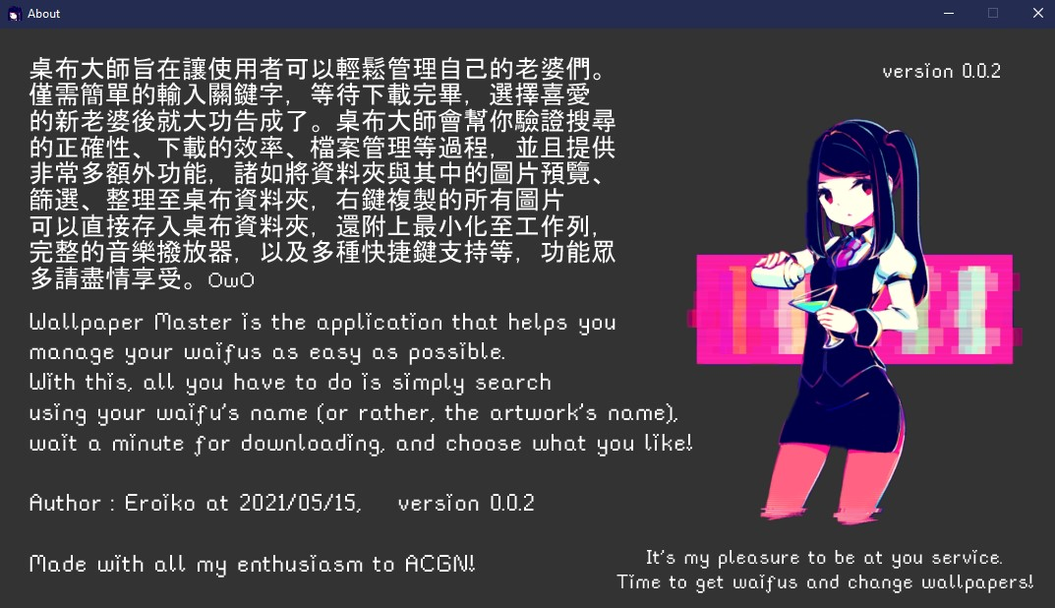
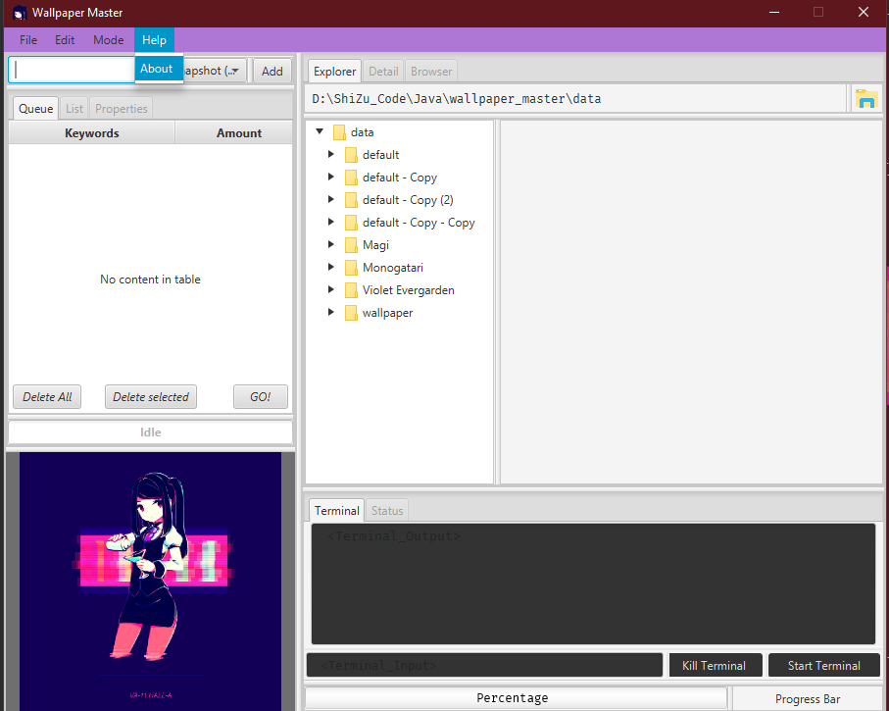

Slide 5
Outline
Main process
Preview and manipulation
Preference
Music with Syamiko
Minimize functions
Wallpaperize
File Explorer
Terminal

Slide 6
Outline
Main process
Preview and manipulation
Preference
Music with Syamiko
Minimize functions
Wallpaperize
File Explorer
Terminal

Slide 7
Main process
Search
Verify
Queue
Fetch
Peek
Download
Full wallpaper
Choose
Wallpaper

Slide 8
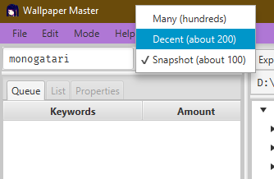
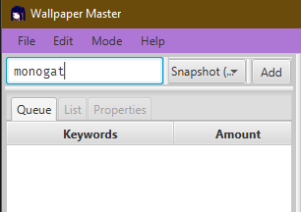

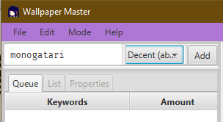
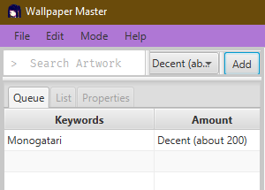
Search
Enter

Slide 9
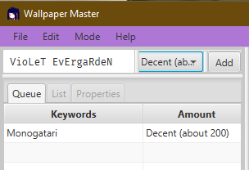
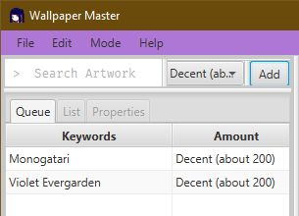
Search
Enter

Slide 10
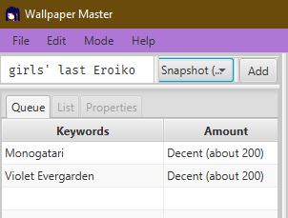
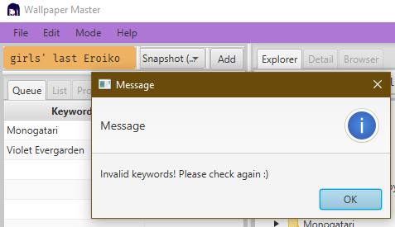
Verify
Enter

Slide 11
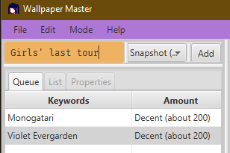
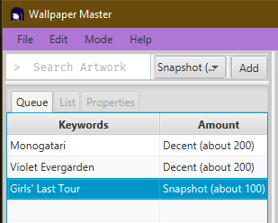
Verify
Enter

Slide 12
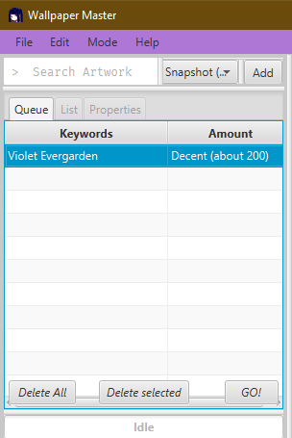
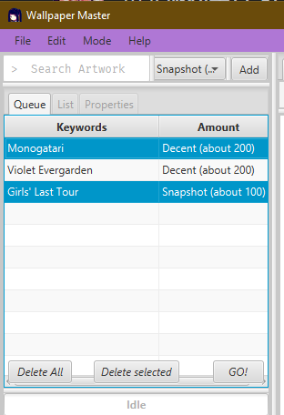
Queue
Delete

Slide 13
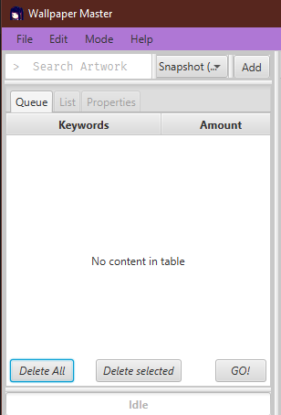
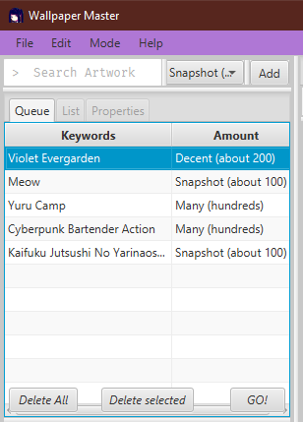
Queue

Slide 14
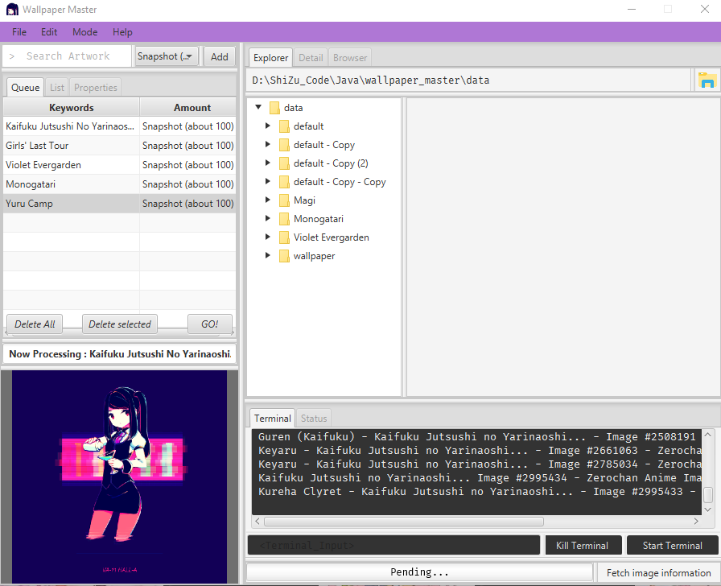
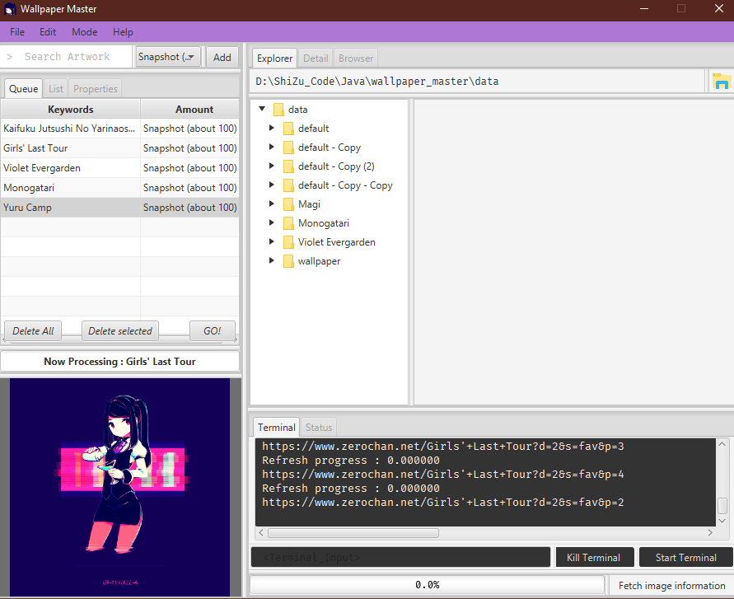
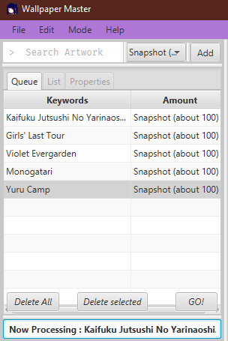
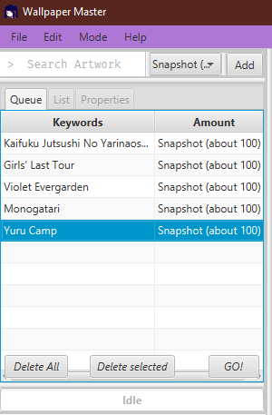
Fetch

Slide 15
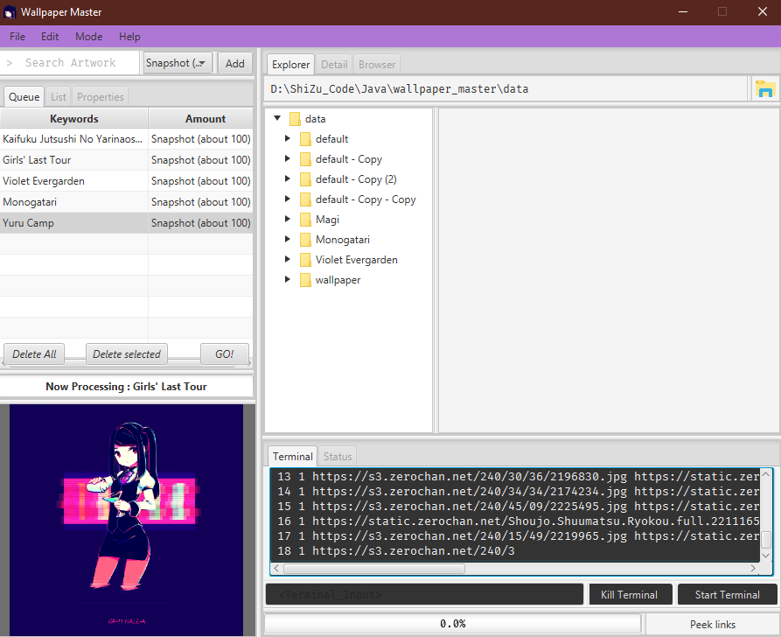
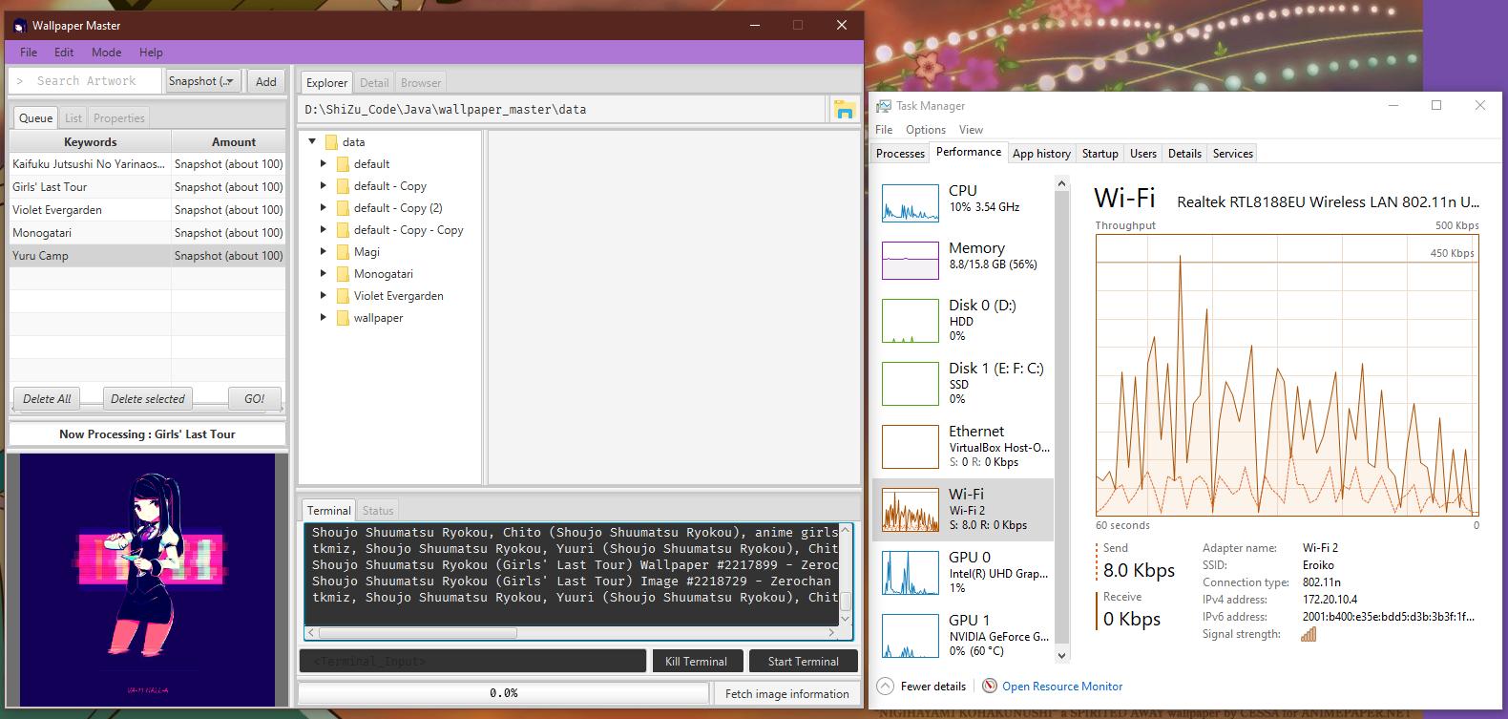
Peek

Slide 16
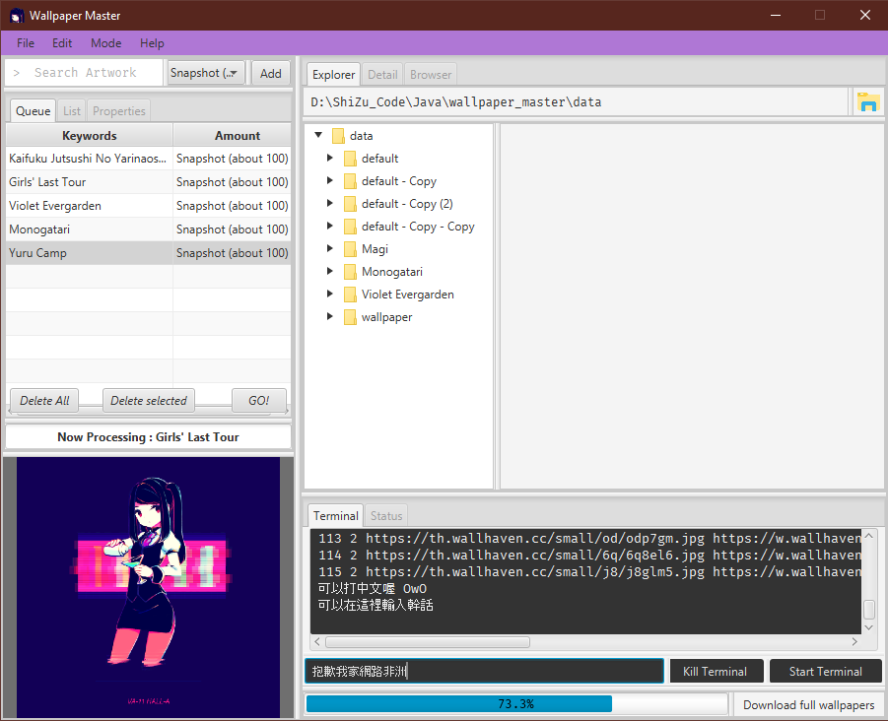
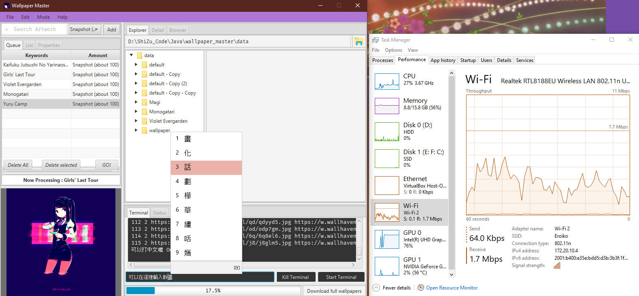
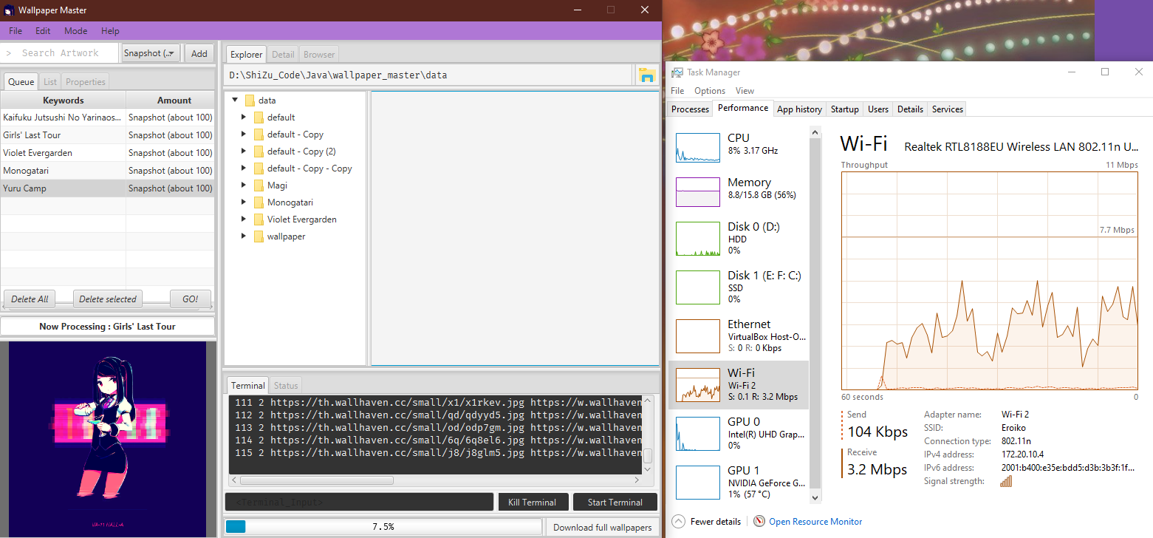
Download Full Wallpaper

Slide 17
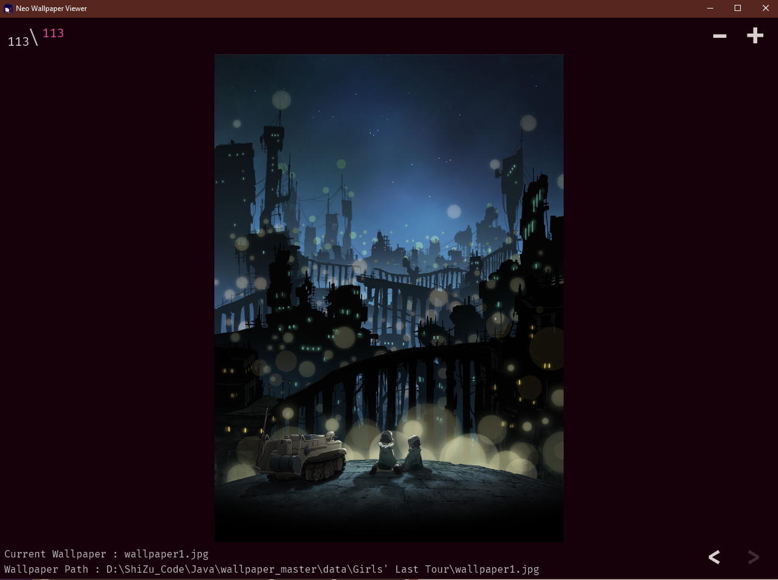
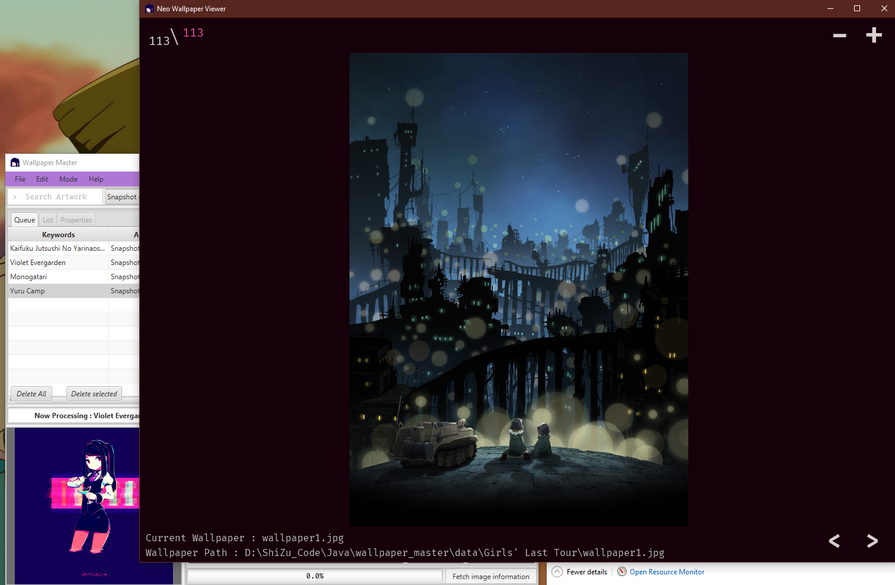
Choose Wallpaper
↓
↑
Mouse
Scroll Up
Mouse
Scroll Down
←
→

Slide 18
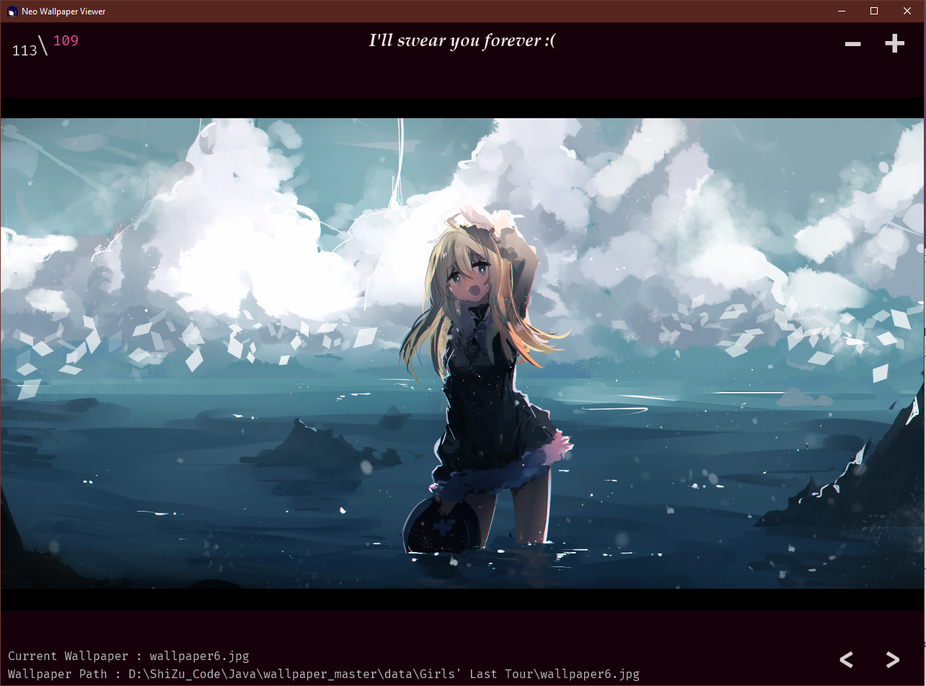
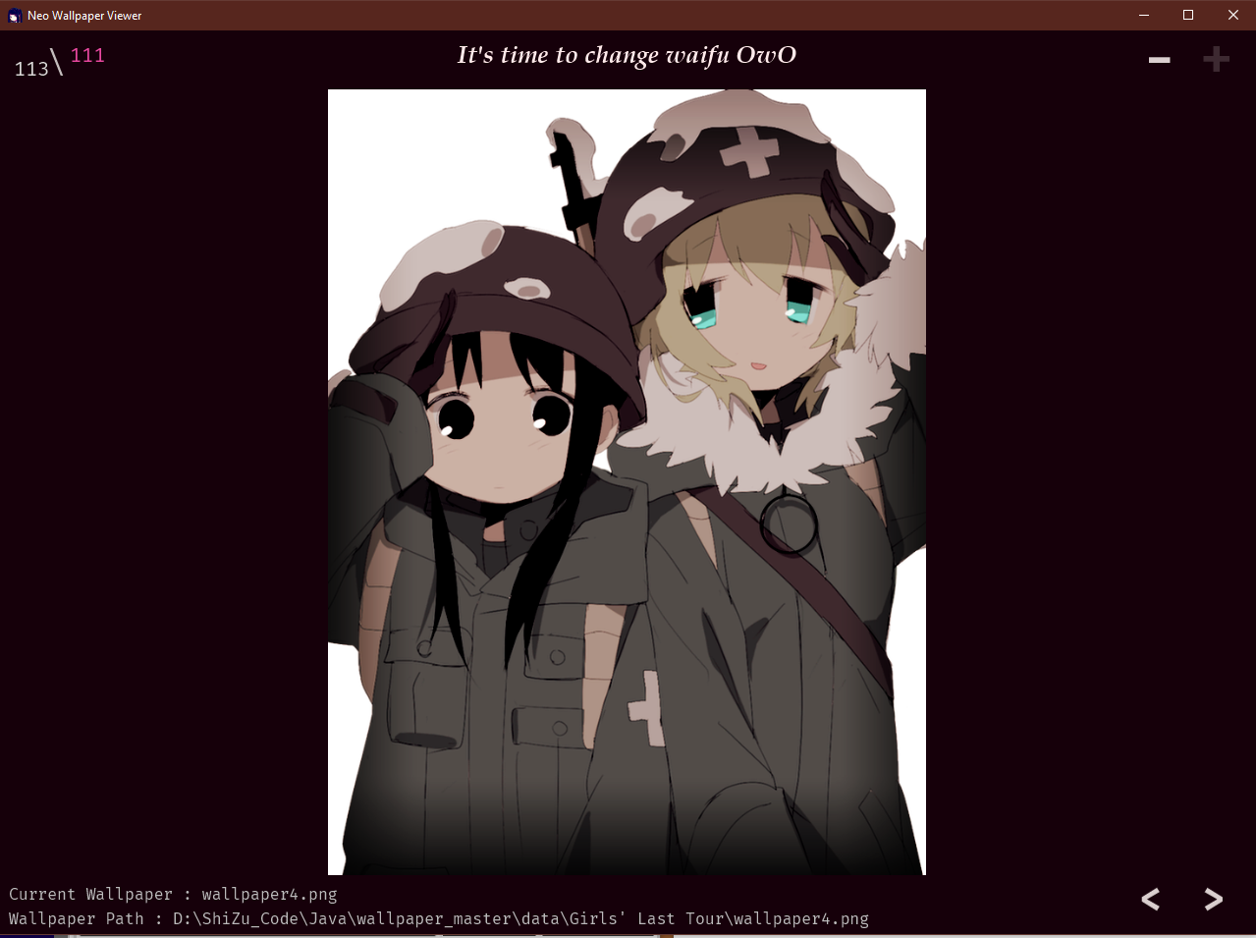
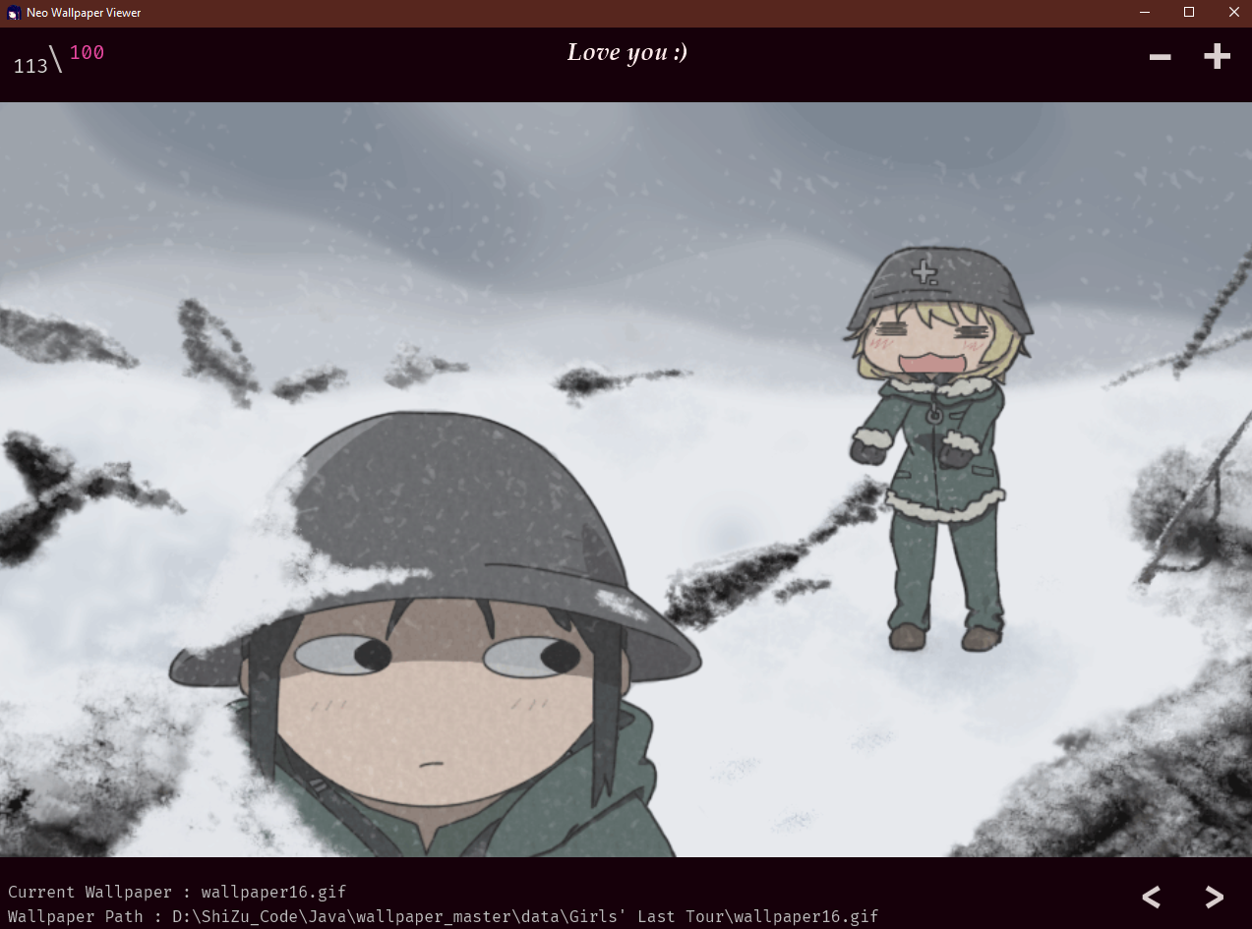
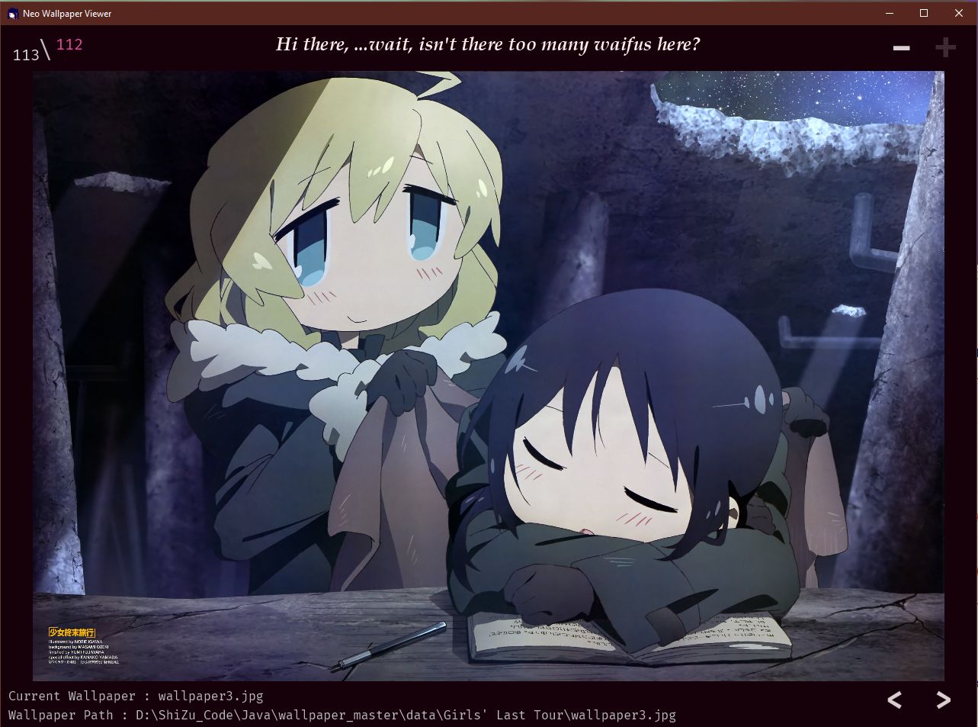
Choose Wallpaper

Slide 19









Choose Wallpaper

Slide 20
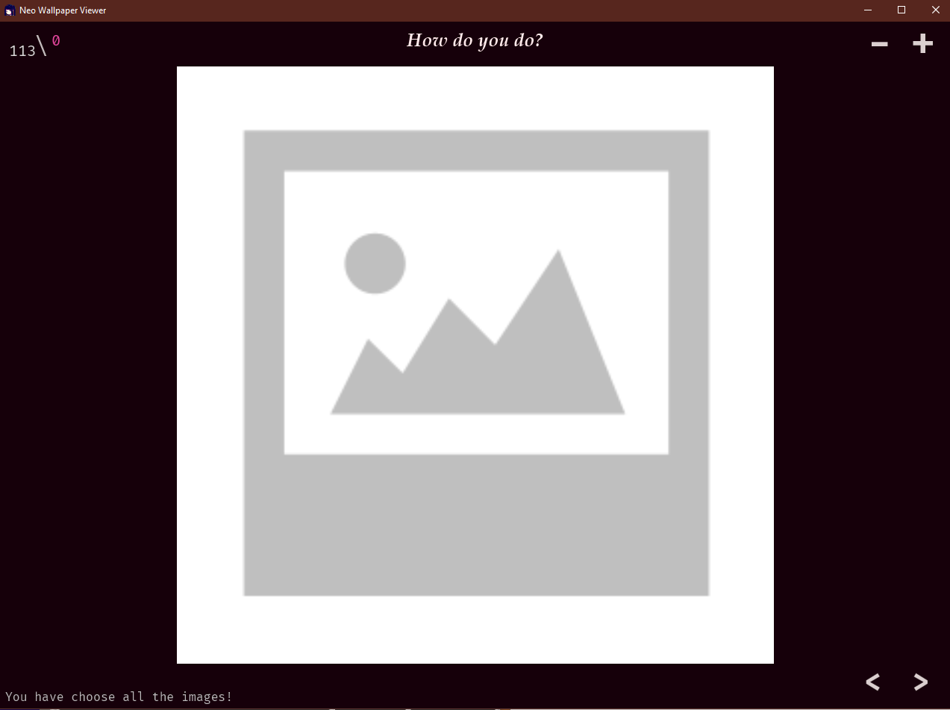
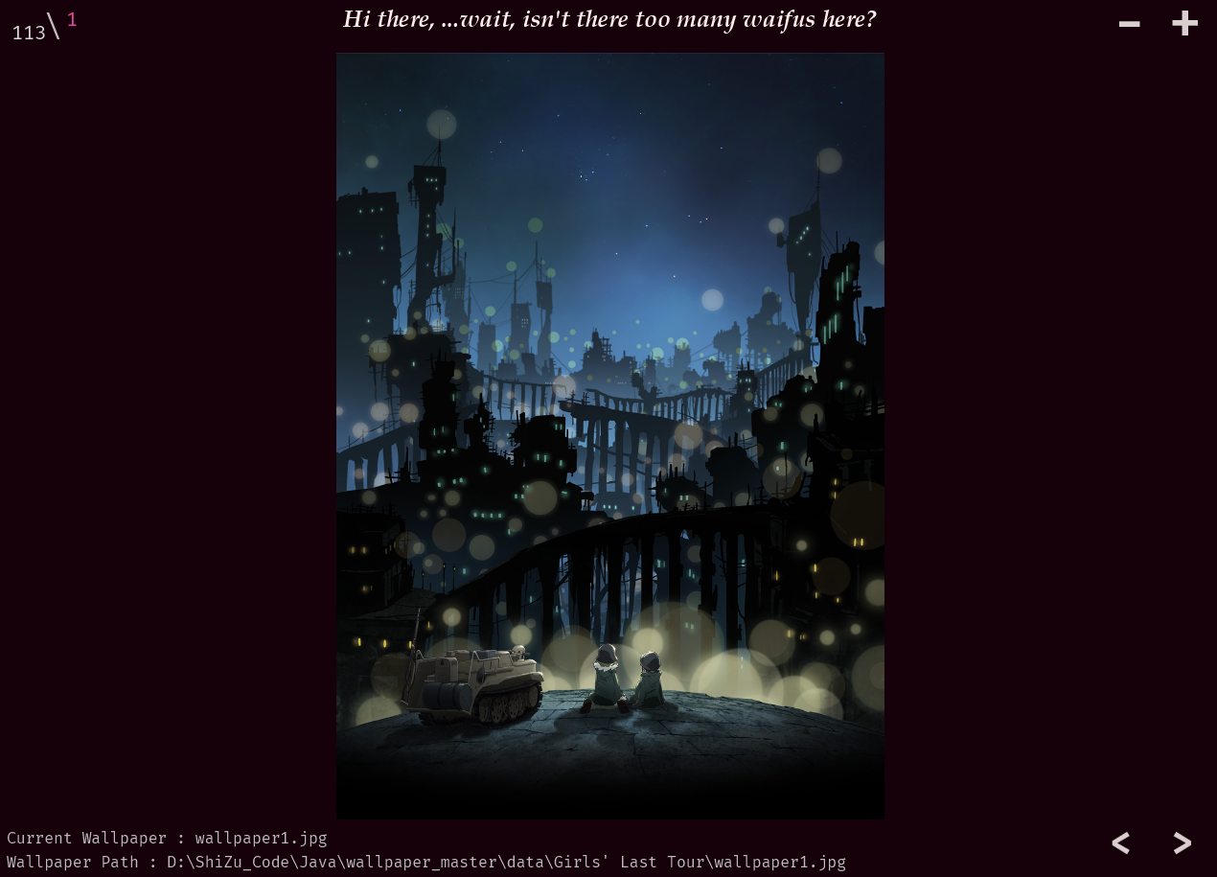
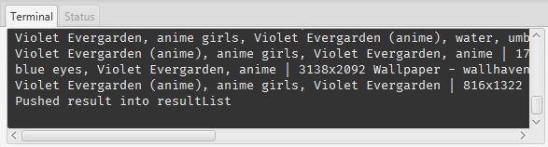
Choose Wallpaper

Slide 21
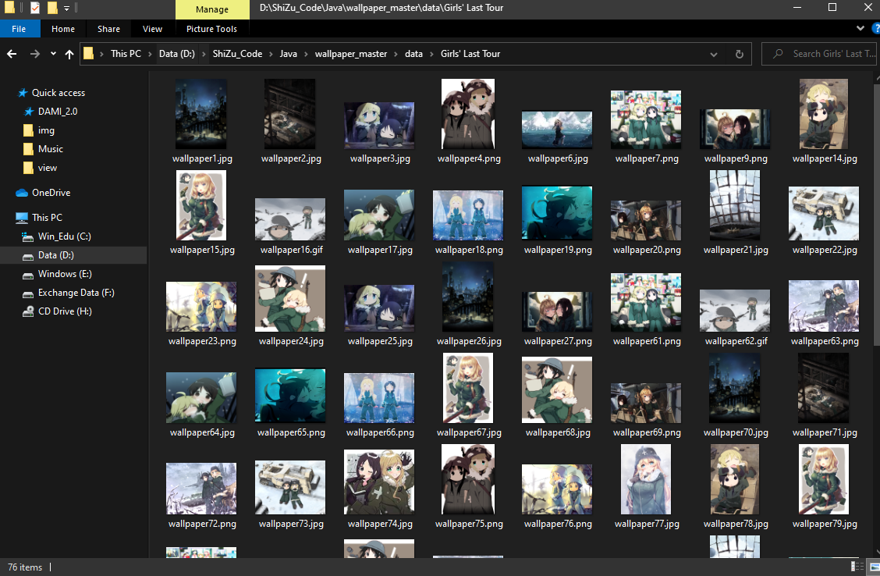
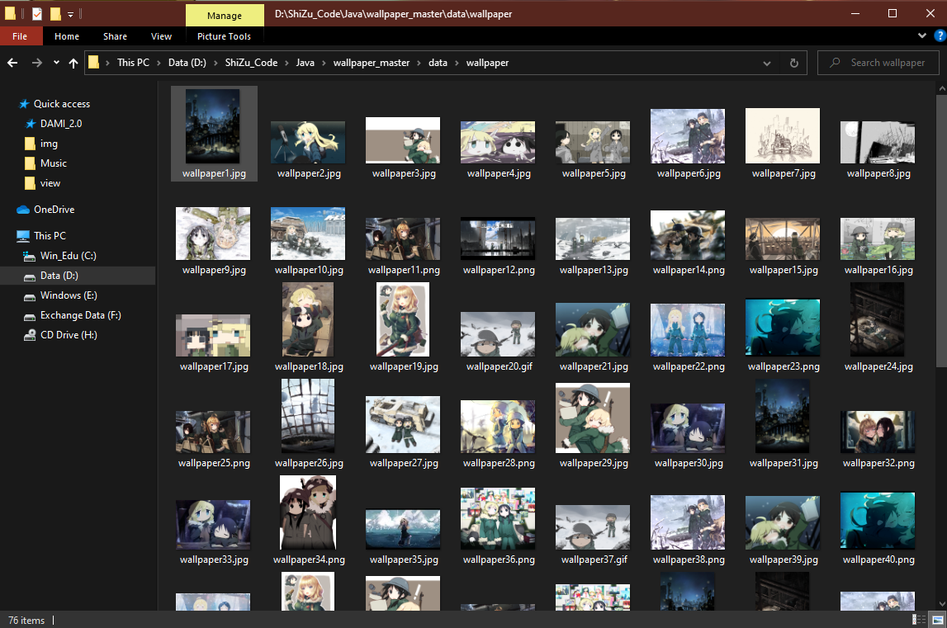
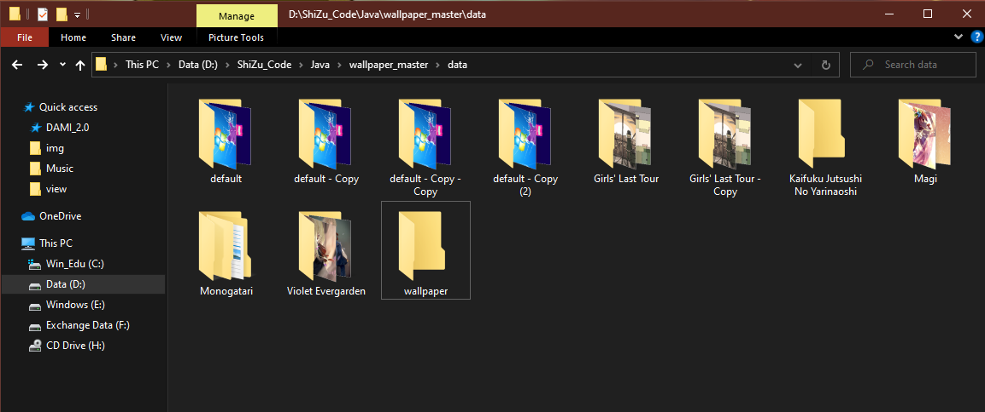
Choose Wallpaper

Slide 22
Preview and manipulation
Interface
Drag
Folder
Preview
Folder

Slide 23
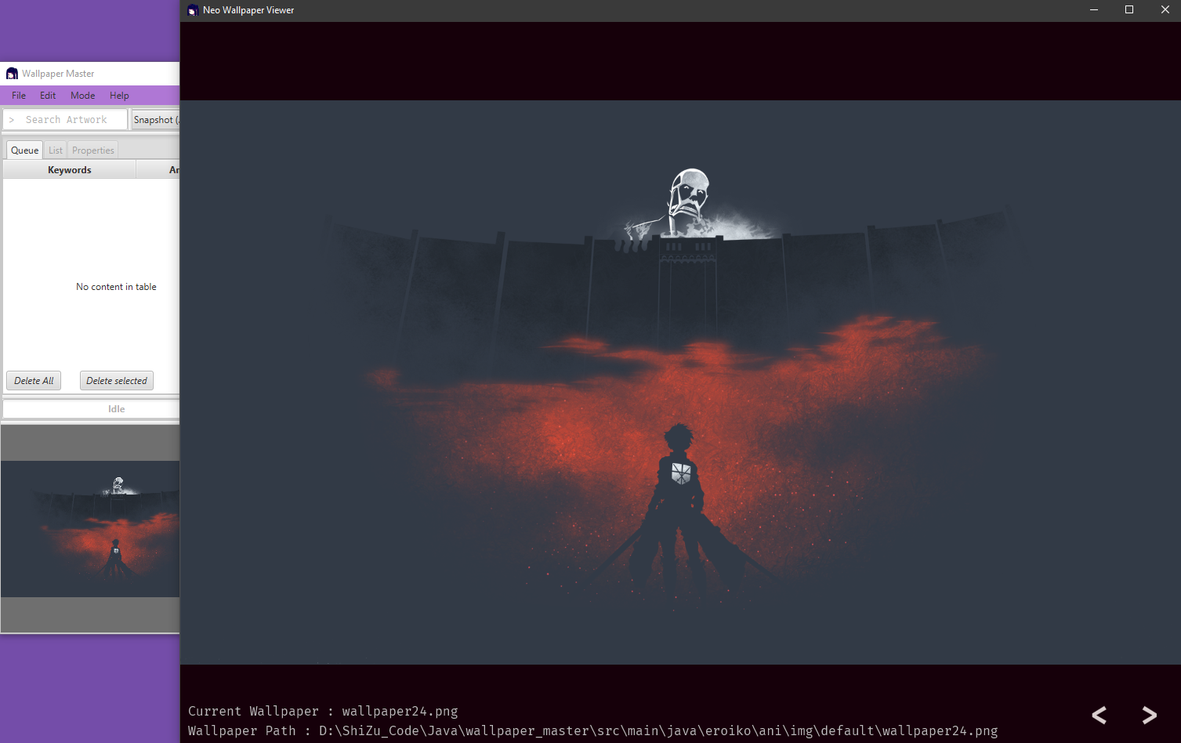
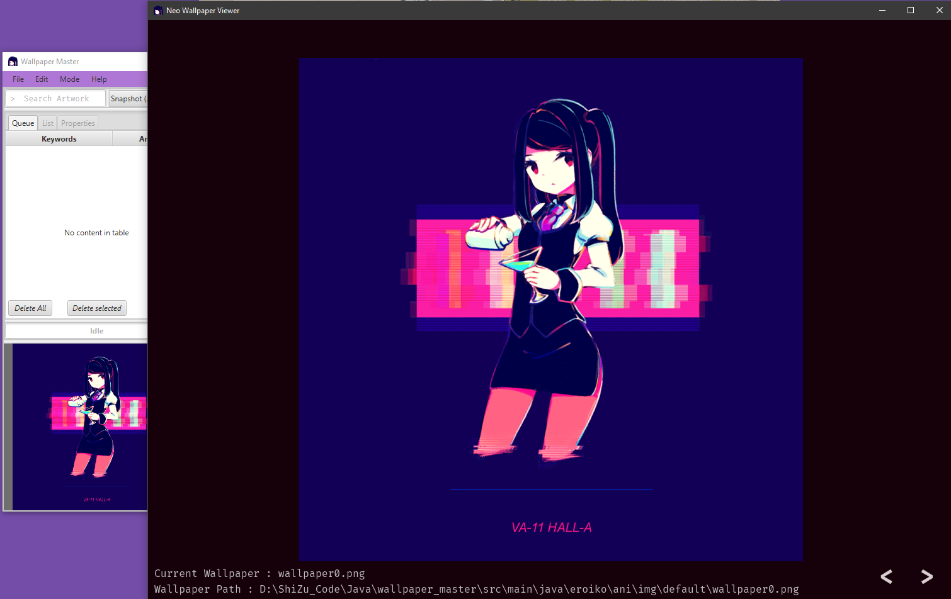
Interface
Mouse
Scroll Up
Mouse
Scroll Down
Mouse
Scroll Up
←
→
Mouse
Scroll Down

Slide 24
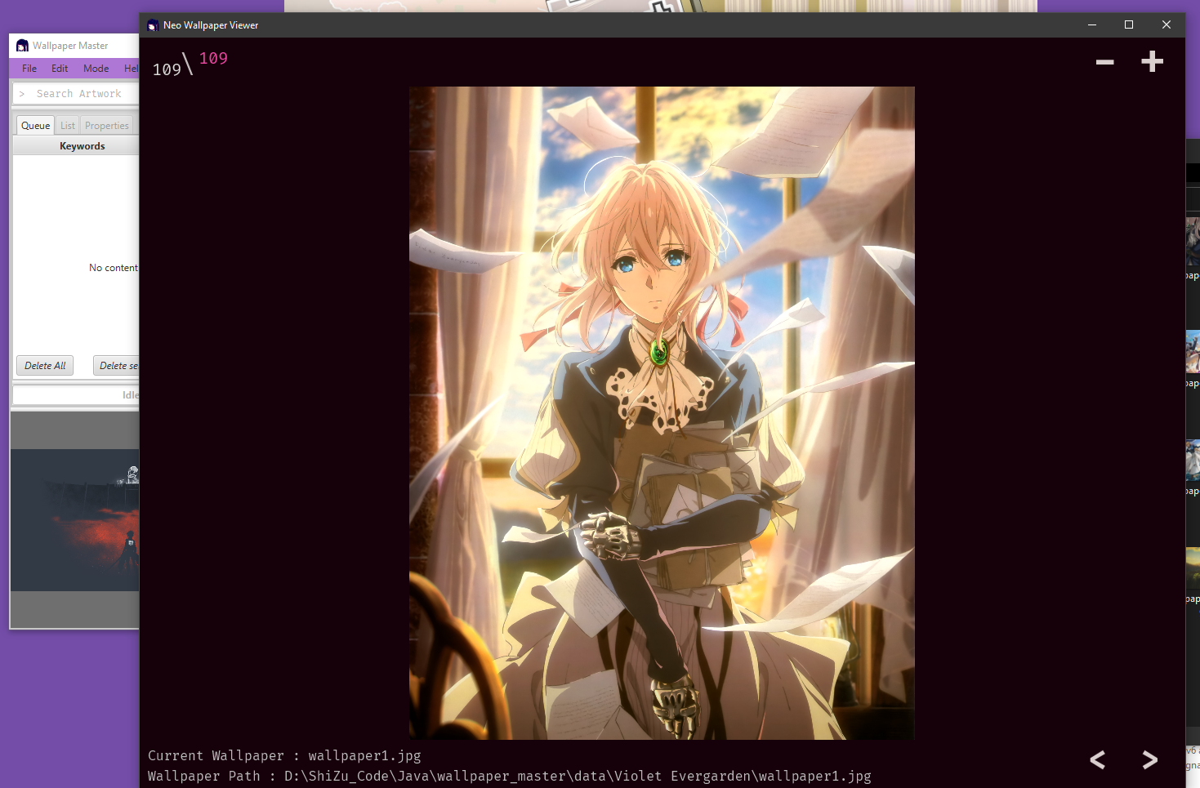
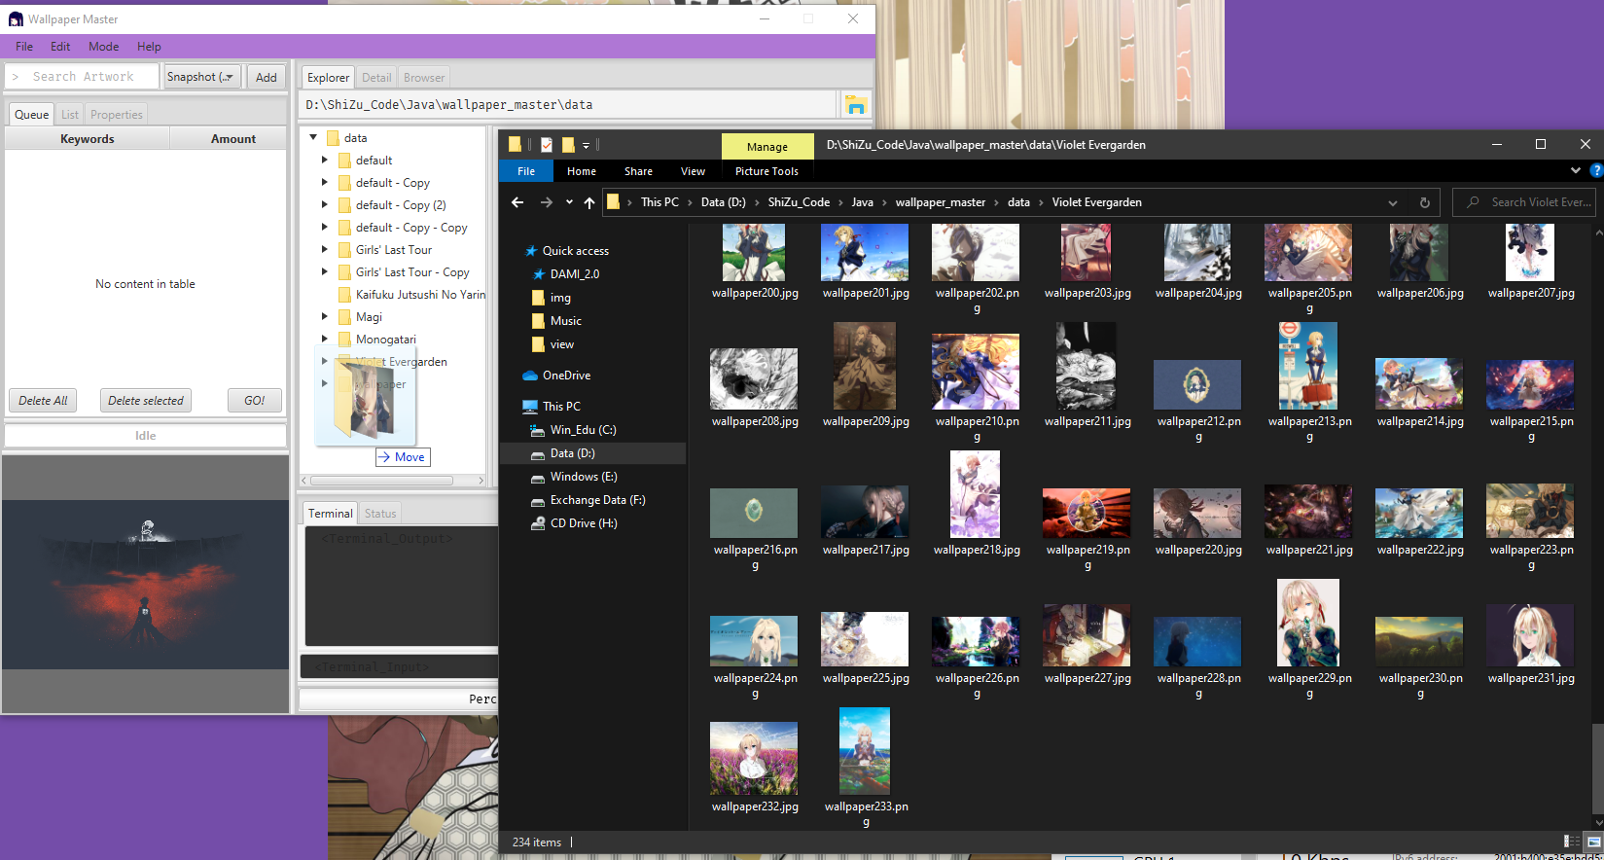
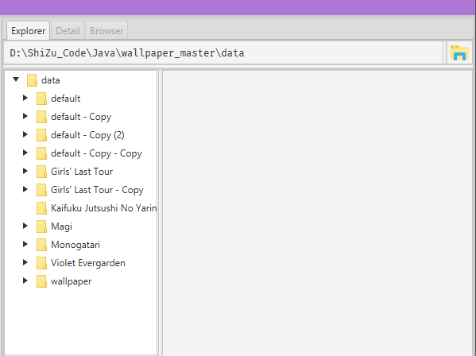
Drag Folder

Slide 25
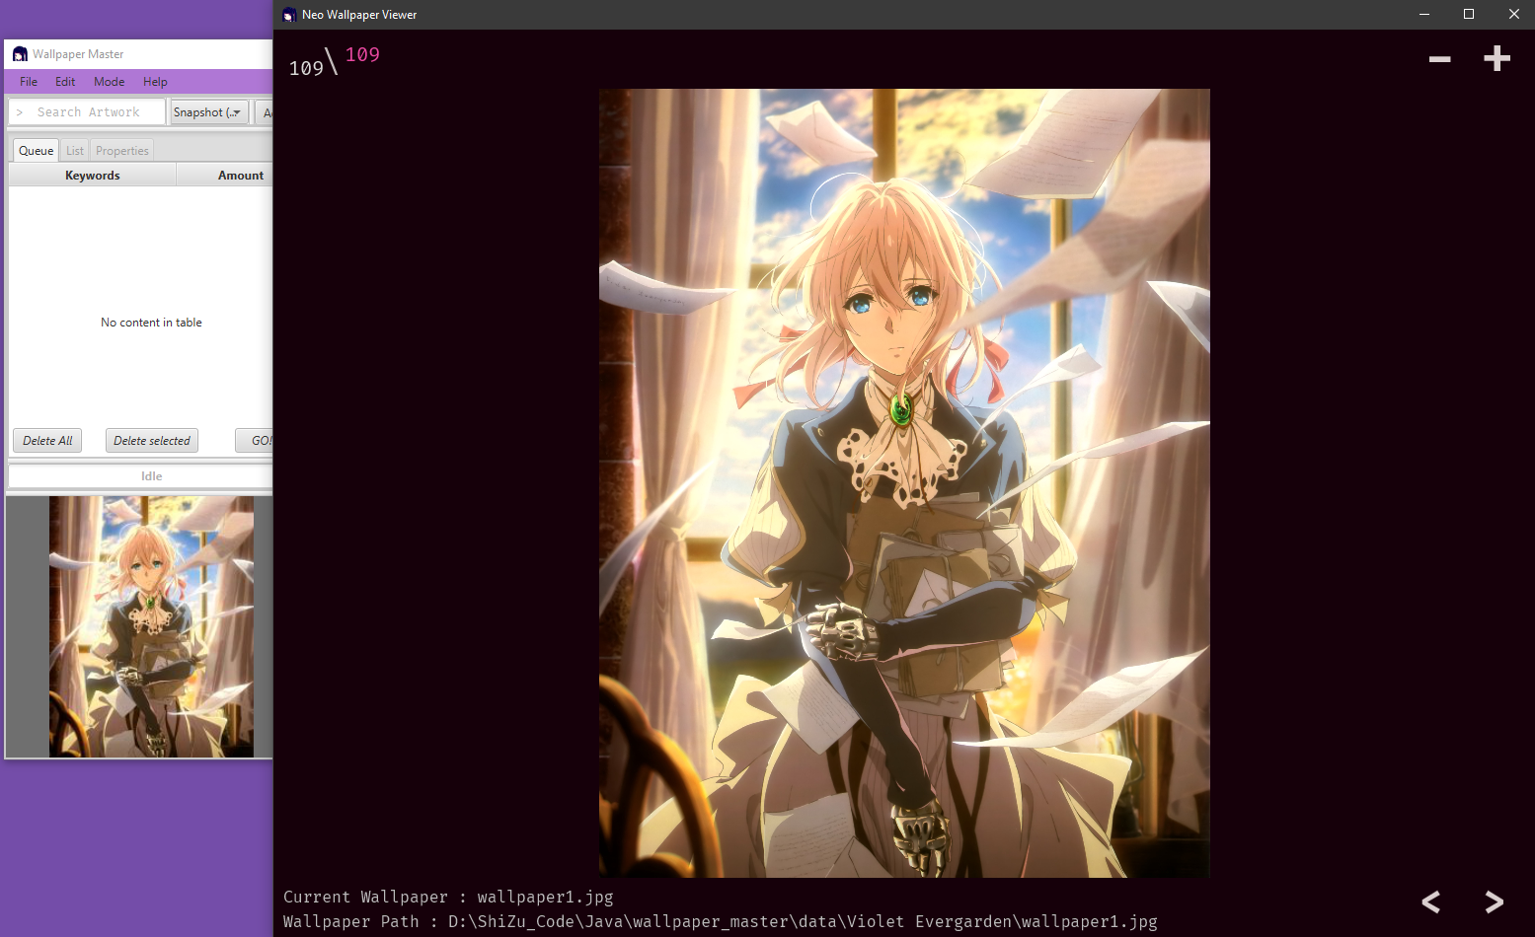
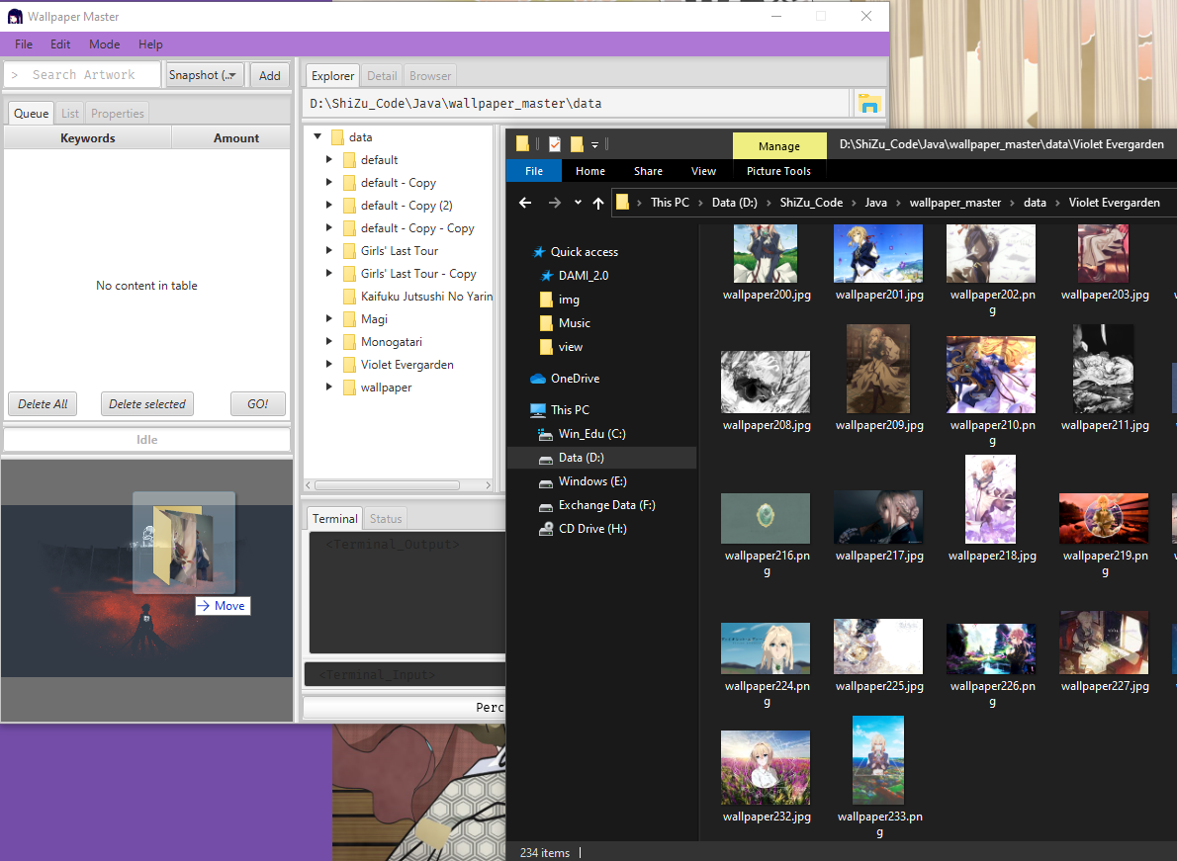
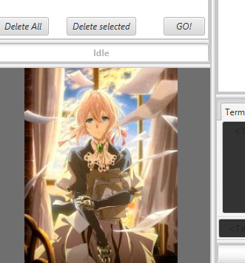
Preview Folder

Slide 26
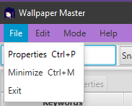
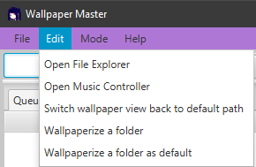
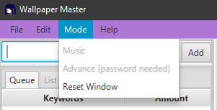
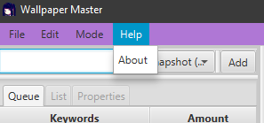
Task bar

Slide 27
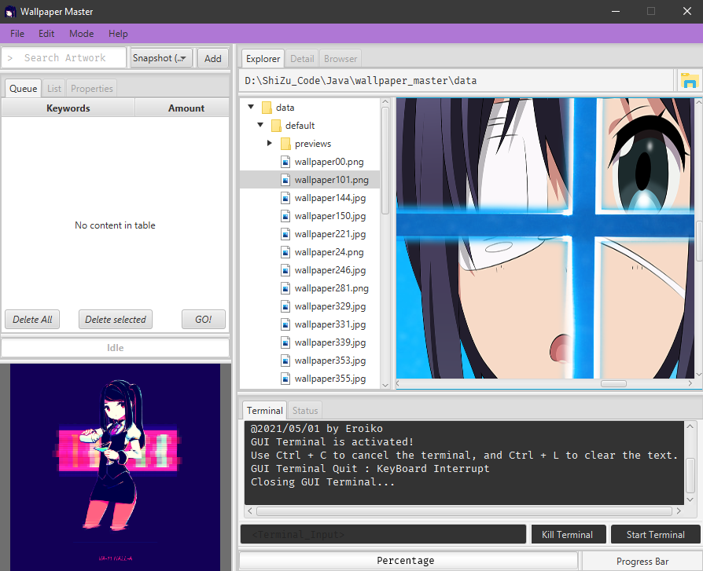

Task bar

Slide 28





Preference
Ctrl + P

Slide 29
Music with Syamiko
Interface
Functions
Add Music

Slide 30



Interface
←
SPACE
→
R
S
L
P
C
I

Slide 31



Functions

Slide 32



Functions

Slide 33
Wallpaperize
Normal
As Default

Slide 34



Normal

Slide 35



As Default

Slide 36
Minimize functions
Minimize
Behavior
Trivial
Functions
Take Clipboard
Wallpapers

Slide 37




Minimize Behavior
Right Click
Ctrl + M

Slide 38


Trivial Functions

Slide 39



Take Clipboard Wallpapers

Slide 40



Take Clipboard Wallpapers

Slide 41
File Explorer
Views
Trivial Functions

Slide 42

Views

Slide 43


Views

Slide 44


Trivial Functions
Right Click

Slide 45
Terminal
Basic
Duality

Slide 46

Basic
Ctrl + L
Ctrl + C

Slide 47



Basic

Slide 48

Duality

Slide 49

Thanks for listening : )
更新啦，哪次不更的

